Slide 1
Agenda
Operating System
Evolution / Types

Slide 2

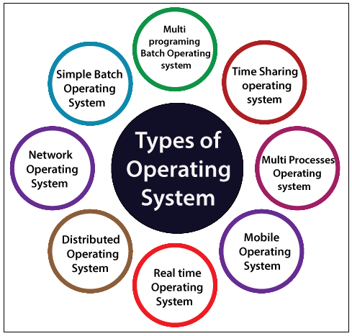
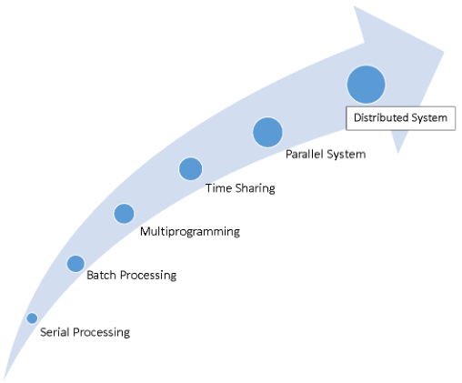
Evolution/Types of Operating System
Operating systems have evolved from slow and expensive systems to present-day technology where computing power has reached exponential speeds and relatively inexpensive costs.

Slide 3
Hierarchy
OS evolution or types of OS based on different categories
Based on sequence
Sequential / Serial OS
Batch OS
Based on user
Single User OS
Multiuser OS
Multiprogramming
Active Multiprogramming
Passive Multiprogramming
Multitasking
Multiprocessing
Tightly Coupled
Loosely Coupled
Time Sharing
Based on Application:-
Parallel OS
Network OS
Distributed OS
Real Time OS
Hard Real Time
Soft Real Time OS
Desktop OS
Cluster OS
Client Server OS
Web Based OS
Mobile OS
Embedded OS

Slide 4
Thank You
We will meet Soon!!!!!!!!!!

Slide 5
Agenda
Sequential Processing / Serial processing
Operating System

Slide 6
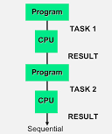
Sequential Processing / Serial processing
In sequential processing the execution of task is performed in serial order i.e. one by one.
It means at a time only one activity can be perform by processing element and processing occurs in the order task is received.
Means Executed is done using the FIFO Manner i.e. First in First Out.
Programmer interact directly with computer hardware i.e. no operating system.
Program in machine code is loaded with I/O device like card reader then operation is performed.
After execution of one task user need to insert next task to processing element i.e. no automatic processing.
Working:-Mainly the Punch Cards are used for this. In this all the Jobs [Pgm+IO Data+ Control Inst]are firstly Prepared and Stored on the Card and after that card will be entered in the System and after that all the Instructions will be executed one by One. But the Main Problem is that a user doesn’t interact with the System while he is working on the System, means the user can’t be able to enter the data for Execution.
Example:-Windows 95 and Windows 98 are examples of operating systems which do the serial processing. And Pentium 3 and Pentium 4 are serial processing computers.

Slide 7
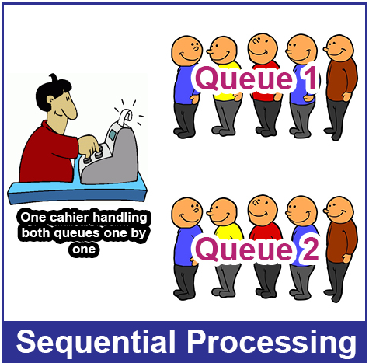
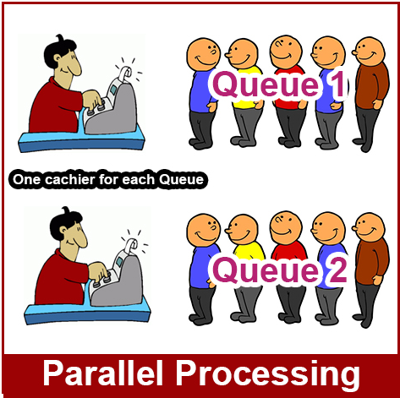
Drawbacks
Setup time is high because, it is hardware dependent we need to do programming on hardware then it can perform specific task as per system program (driver) processing.
Loading time is large
Less Resource utilization and time consuming activity.
Run-time complexity cannot be improved even with many processors.
Advantages:-
Sometimes sequential processing is faster than parallel, for the parallel needs to gather all the parallelized data into one, while it's not needed on the sequential.

Slide 8
Thank You
We will meet Soon!!!!!!!!!!

Slide 9
Agenda
Batch Operating System

Slide 10
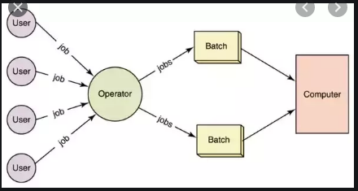
Batch Processing OS
As we have observed some drawback of sequential processing, and in order to overcome this problem, batch processing was introduced, where all processes are collected and then it submitted to the operator.
Batch processing is a form of data processing in which a number of inputs are grouped.
Then operator will sort all programs into batches in different categories. (i.e. compiler oriented like FORTRAN, PASCAL etc., as shown in figure)
Actually the data is written on punch card and submitted to computer Operator then operator handles the task. Then the operator submits it to processing element and finally processor will perform entire processing

Slide 11
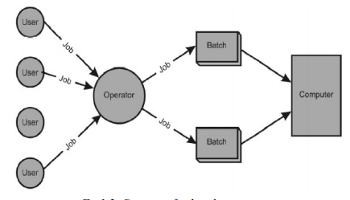
Example
I/P
Suppose users submitted following scenario:-
User 1---pgrm1 ---C Language
User 2---pgrm2----C language
User 3---pgrm3----C++ language
User 4---pgm4 ---Fortran
User 5--pgrm5---Pascal
User 6---Pgm6 ---Fortran
After that Batches are created by Operator
Will sort the similar task based on Language
Batch1---C Language --2 pogroms
Batch2---C++ Language ---1 pogroms
Batch3---Fortran Language --2 pogroms
Batch4 ---Pascal Language—1 pogroms

Slide 12
Advantages and Disadvantages
Advantages:
Batches are beneficial for large jobs.
User can not interact with process execution.
User can submit their program and take O/P after some time, so would beneficial to large size task.
It increases CPU utilization by keeping processor busy.[idle time is less]
It is also possible to give/provide priority to processor
Batch processing takes much of the work of the operator to the computer.
Increased performance as a new job get started as soon as the previous job is finished, without any manual intervention.
Disadvantages:
If process is small in size it has to wait for other process.
Time consuming to final execution.
Lack of interaction between the user and the job.
CPU is often idle, because the speed of the mechanical I/O devices is slower than the CPU.
Difficult to provide the desired priority.[sometimes]
It is sometimes costly
Difficult to debug program.
A job could enter an infinite loop.
Due to lack of protection scheme, one batch job can affect pending jobs.
E.g. - Bill processing, Pay roll system, Bank Statements, etc.

Slide 13
Thank You
We will meet Soon!!!!!!!!!!

Slide 14
Agenda
Single user and Multiuser
Operating System

Slide 15
Single User OS
Operating system evolution is also categories on the basis of how many users can use a system at a time (i.e. single user or multiuser at a time).
Single user OS is convenient to the single user to perform dedicated task.
In single user OS, other user can not interact with other working users (at a time only one).
The core part of single user OS is one kernel image that will run at a time i.e. there is no other facility to run more than one kernel images while booting e.g. DOS, Windows 95 (most of UNIX version are single user mode).
Nowadays, it is not too convenient because everyone need multiuser interaction and large processing.
Single user OS is commonly used for home computer system.
These types of OS are typically used in small devices like wireless phone and two way messaging devices.
It is not useful for a computer or other device, intended to run multiple programs at once
Security Problem, It is not intended for several tasks as same given time

Slide 16
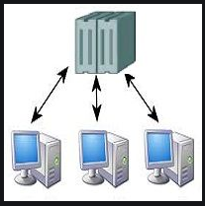
Multi User OS
Multiuser OS is an application or S/W that allows multiple users to access any system.
The concept of Multiuser OS is as; if any OS having multiple kernel image is loaded
while the user login to the client computer. (Like a thin client environment).
When user boot their system then single kernel image is loaded for specific user.
In simple term, multiuser OS are those in which multiple kernel images get loaded with number of users.
It is good provision for all users to complete their task by simply remote login or login to server system.
The nature of S/W or application is inbuilt multiuser (most of the time).
Consider, an application as an antivirus , banking s/w, online reservations s/s which is having multiuser functionality i.e. it having a capacity to handle more user at a time.
Every user will get separate environment for processing.
In thin client environment, when dump (diskless) computer are logged in then single kernel (OS) copy is invoked from server e.g. UNIX, Linux, and Mainframes such as IBM AS400

Slide 17
Multi User OS
Features
Multi Tasking
Resource Sharing
Background Processing
Example:-
Unix
Virtual Memory System
Mainframe OS
Windows NT
Windows 2000
Windows XP
Types
Distributed Systems
Time-Sliced systems
Multiprocessor System

Slide 18
Thank You
We will meet Soon!!!!!!!!!!

Slide 19
Agenda
Multiprogramming
Operating System

Slide 20
Multiprogramming
To overcome the problem of under utilization of CPU and main memory, the multiprogramming was introduced.
Main objective of multiprogramming is to manage entire resources of the system.
The multiprogramming is interleaved execution of multiple jobs by the same computer[uniprocessor].
In processing mechanism multiprogramming is one of the Processing where more than one programs can "Resides in main memory" at a same time.
With the help of memory management technique memory is allocated to processes without any interleaving.
When program resides in main memory user can not interact with system all the decisions are taken by system itself. (user can not have choice to select process).
In a multiprogramming system there are one or more programs loaded in main memory which are ready to execute. Only one program at a time is able to get the CPU for executing its instructions (i.e., there is at most one process running on the system) while all the others are waiting their turn.

Slide 21
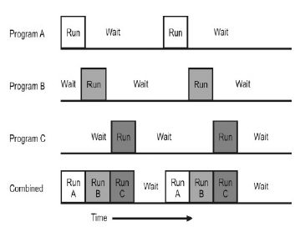
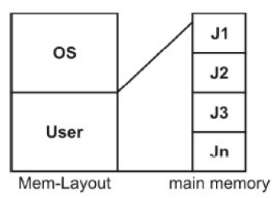
Working
One system module will select proper process and submit it to processor (From main memory) for example consider figure (case a) where memory layout is divided into OS and user control.
The user control space consists of four task (J1, J2, J3, and Jn) that means at a time all 4 task are present (resides) in main memory.
Now it's a duty of system (scheduler) to select one of process and give it to the processor.
Generally all processes are having CPU and I/O burst during their life time, it frequently switches from one burst to another burst during operation.
Example:-
It is Non-preemptive.
But When 1 process running and it voluntary took break from CPU burst to IO burst.
So this time can be utilized

Slide 22
Advantages and Disadvantages
Advantages
High and efficient CPU utilization.
User feels that many programs are allotted CPU almost simultaneously.
CPU is used most of time and never become idle
The system looks fast as all the tasks runs in parallel
Short time jobs are completed faster than long time jobs
Multiprogramming systems support multiply users
It reduces total read time that is required to execute a job.
Response and waiting time is shorter
Disadvantages
CPU scheduling is required.
To accommodate many jobs in memory, memory management is required.
Tracking all tasks/processes is sometimes difficult to handle
Due to high load of tasks, long time jobs have to wait long
Memory Fragmentation
Examples:-
Microcomputers like as MP/M, XENIX, and ESQview.
Windows O/S.
UNIX O/S.

Slide 23
Passive and Active multiprogramming
In multiprogramming a list of programs are queued and switch programs from active to passive states.
If the program turns into a passive state another program would be considered as active.
When a program that is being processed by the CPU issues an I/O command, control is passed to the I/O processor and the CPU is free to process other programs. This is known as passive multiprogramming.
Passive multiprogramming is characterized by an event which generates interrupt that cause task switching.
These events are usually the result of a program-initiated action, such as sending a record to an output device, or dividing by zero.
The problem with this is that the interruptions are primarily controlled by the programs and not by the CPU.
As an answer to this problem, the CPU was given the control with the advent of active multiprogramming.
Active multiprogramming enabled a program to use a preset slice of CPU time before putting the program on hold to process another program
Active multiprogramming is characterized by time generated interrupts that cause task switching.

Slide 24
Thank You
We will meet Soon!!!!!!!!!!

Slide 25
Agenda
Multitasking Operating System

Slide 26
Multi Tasking OS
Multitasking is an ability to do more than one task at a time (but practically it is not possible).
E.g. if a man is listening song at the same time he or she can browse the content from web.
In order to achieve multitasking we need to share some resource like CPU and Memory.
There are two basic types of multitasking system
Preemptive and
Co-operative/non preemptive.
In preemptive multitask, the OS distribute the part of CPU time slice to each program and
In co-operative each program can control the CPU for as long as it needs.
In multiprogramming and multiuser system user can interact with system i.e. it can control the execution of multiple program.
E.g. Reading a news paper and taking sip of tea.
In multitasking (modern OS) time sharing is best manifested, because each running process takes only a fair quantum of the CPU time.

Slide 27
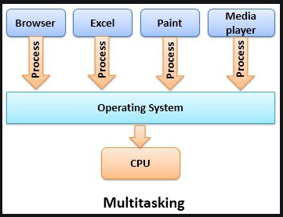
Multi Tasking OS
Multitasking is a logical extension of a multiprogramming system that supports multiple programs to run concurrently.
Means multitasking is multiprogramming with time sharing
True multitasking is the capable for executing and process multiple tasks concurrently without taking delay instead of switching tasks from one processor to other processor
Main advantages is better response time and executing multiple process together
Advantages :-
Time Shareable/Shared
Manage Several Users
Background Processing
Good Reliability
Use Multiple Programs
Optimize Computer Resources

Slide 28
Thank You
We will meet Soon!!!!!!!!!!

Slide 29
Agenda
Multiprocessing
Operating System

Slide 30
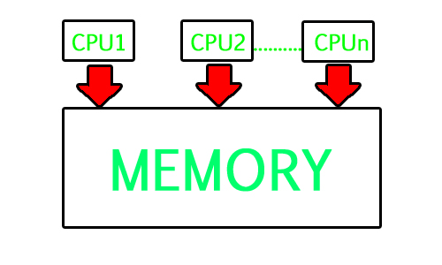
Multiprocessing
Why?
To speed up processing power
If single CPU is not supporting
Only CPU speed matters
Not Extra memory ,IO devices, bus, register required
Instead of purchasing new use existing

Slide 31
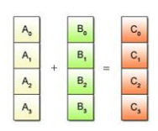
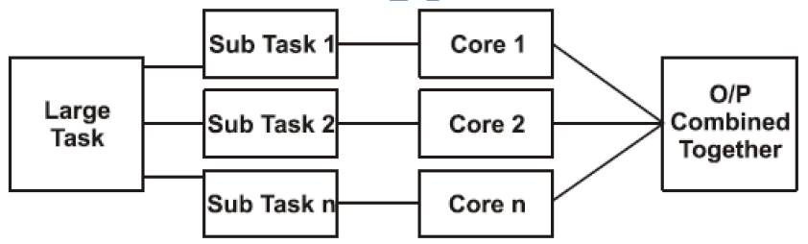
Multiprocessing
Multiprocessing is also called multicore programming.
It works on the principle where large task is divided into smaller sub task and delegate
those task to more than one processor which are connected (tightly) to computer system
Simply we can say that multiprocessing is a mechanism in which two or more
program or segment of instruction simultaneously run by computer (CPU).
In multiprocessing the processor can be used to execute a single sequence of instruction in multiple contents (single instruction multiple data SIMD) often used in vector processing.
Multiprocessing uses a distinct communication architecture to accomplish this.
A multiprocessing OS needs a mechanism for the processors to interact with
one another as they schedule tasks and coordinate their completion.
Best example of such system is parallel processing

Slide 32
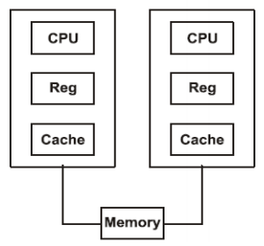
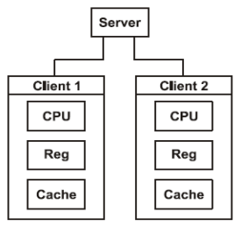
Multiprocessing
This processing is of two types, one is the multiprocessing which involves computer H/W and S/ W architecture where two or more identical processor are connected to a single shared main memory.
That called tightly coupled system and symmetric multiprocessing (SMP) it does not carry master slave relationship between processor . It also has its own set of register and caches (All processor).
Here each processor contains a similar copy of the operating system and they all communicate with each other. All have equal rights
Where as in an asymmetric multiprocessing the system is loosely coupled in which all CPU are treated equally
For example system might not allow (either at the H/W & OS Level) one CPU to execute OS code or might not allow one CPU to perform I/O Operation, Such environment exist master slave relationship among processors.
Server having rights to assign task to same processor but individual processor may perform task on its own processing element and works as uniprocessor system. Task assigned as per requirement

Slide 33
Multiprocessing
Advantages
Through put Increase
Reliability
Cost Reducing
True parallel execution
Disadvantages
More complex
Overhead of coupling
Large memory

Slide 34
Thank You
We will meet Soon!!!!!!!!!!

Slide 35
Agenda
Time Sharing
Operating System

Slide 36
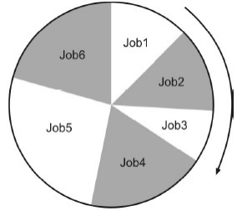
Time sharing OS
Time sharing OS is a logical extension of multiprogramming. Also called as multitasking
It means it is possible to have more than one processes in main memory at a time. (i.e. Time Quantum) Figure shows the detailed view of time sharing OS.
If a process completes their execution within a given time slice then no problem but if any process remains partially to execute their portion then it will get next time quantum for execution purpose after other process completes.
In order, to provide more interactiveness and save response time it is most preferable.
In time sharing, shuffling of job is possible on time quantum basis.
It is an illusion of several job executing simultaneously.
The use of scheduling and context switching are needed.
In time sharing system resources are shared among different jobs for their execution.

Slide 37
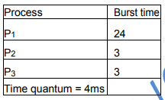
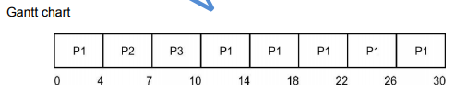
Time sharing OS
Time sharing means to share time into multiple slots in several processes. Time sharing system allowing multiple clients for getting access to specific system resources at once from different remotely locations
And multi tasking allows a system to execute multiple task or process simultaneously

Slide 38
Time sharing OS
Advantages:
Time sharing system reduces CPU idle time.
It leads to quick response.
It is convenient to small user.
Effective use of resource by sharing to different processor.
Every task makes same opportunity.
Example:-
UNIX
Multics
Linux
Windows 2000 server
Windows NT server
Disadvantages:-Time sharing system leads to some drawback due to the nature of interactiveness, multiprocessing and multiuser operation.
Question of Security:
Problem of Communication:
Question of Reliability: The interactive nature of Time sharing system causes unreliability because the data content may be lost which will lead to failure.
It consumes much system resources

Slide 39
Thank You
We will meet Soon!!!!!!!!!!

Slide 40
Agenda
Parallel Operating System

Slide 41
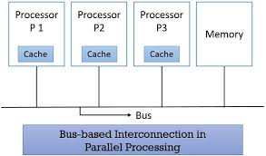
Parallel Operating System [POS]
Parallel processing is a superset of multi processing system.
Purpose:-Parallel Processing Systems are designed to speed up the execution of programs by dividing the program into multiple fragments and processing these fragments simultaneously.
Parallel computing is used to increase performance and for scientific computing
Principle :- Parallel processing works on the principle, where the large task is divided into small sub task and is assigned to individual core present in computer system and finally all O/P will merge together.
Parallel processing is tightly coupled where memory, clock, bus etc are shared on same system.
Communication :-Inter Process Communication (IPC), it is achieved by shared memory mechanism.
Data dependency concept is important if subtask1 depends on subtask 2, so they have to wait for each other, to produce an O/P. Dependency may be in the form of I/P dependency, O/P dependency, flow dependency, etc.

Slide 42
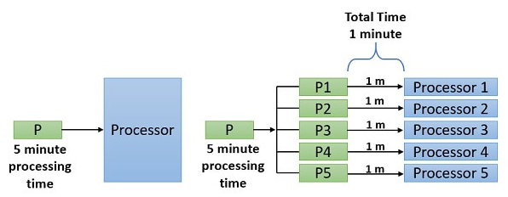
Advantages
Throughput increases:-
Presence of multicore architecture leads to more outcomes.
Simply, the availability of more processing elements leads to perform more tasks within less time so that maximum throughput can be achieved.
Economic of Scale:-
If we compare a single processing and multiprocessing environment it saves lot of resource (memory).
For example,
Increase Reliability:-
Because of availability of many replicated resource, there is fault tolerance.
If one of the processing elements gets failed it does affect other processing element. Hence user can simply rely on multiprocessing system.
Last advantage of parallel processing, is that it works on divide and conquer rule in which lot of advantages are possible.
Concurrency , time saving

Slide 43
Disadvantages
Parallel systems are more difficult to program than computers with a single processor because the architecture of parallel computers varies accordingly and the processes of multiple CPUs must be coordinated and synchronized
Power consumption is high due to multi-core architecture.
High Configuration Hardware required
Its very difficulty to develop parallel software's
Lack of scalability between mem and cpu

Slide 44
Thank You
We will meet Soon!!!!!!!!!!

Slide 45
Agenda
Network Operating System

Slide 46
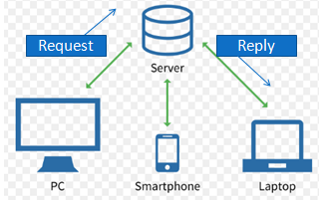
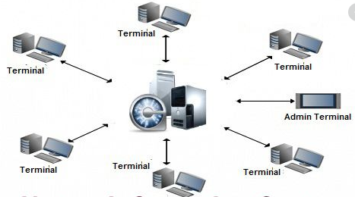
NOS
Many computers are connected via some connecting device which ultimately forms a network.
Network Operating System includes special functions for connecting computers and devices into a local-area network (LAN) or Inter-network.
NOS’s are the middleware between local OS of one computer to local OS of another computer.
It’s a responsibility of sender and receiver that, transfer takes place properly.
NOS (Network OS) has separate system images for every user.
During this time, the total care of task at network level is cared by NOS along with network paradigm and format.
NOS are a loosely coupled OS where each system has their own components (processing element).
During data transfer on N/W the concept of marshaling and demarshaling (encapsulation) is needed i.e. only end user can access data while middle one can't.
NOS use high level API, Socket, RPC for process communication.

Slide 47
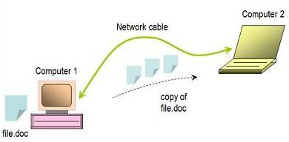
NOS
Purpose:-
NOS is the extension of traditional OS and it is specially used for Resource sharing and information sharing on the networks
It also gives the capability to manage data, users, groups, security, applications, and other networking functions on Server
Applications:
Remote Login
File Transfer
N/W Browsing
Remote Execution
Messaging
Examples:
Novell Netware,
Windows NT/2000,
Linux, Sun Solaris,
UNIX, and
IBM OS/2

Slide 48
Advantages/Disadvantages
Advantages
Highly stable centralized servers
Security concerns are handled through servers
New technologies and hardware up-gradation are easily integrated into the system
Server access is possible remotely from different locations and types of systems
Disadvantages
NOS are less fault tolerant than distributed OS
Servers are costly
User has to depend on a central location for most operations
Maintenance and updates are required regularly

Slide 49
Thank You
We will meet Soon!!!!!!!!!!

Slide 50
Agenda
Distributed Operating System

Slide 51
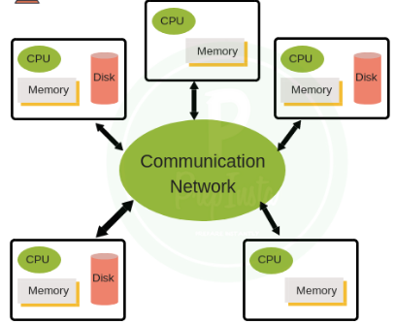
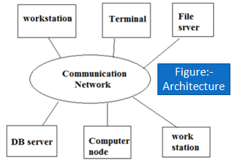
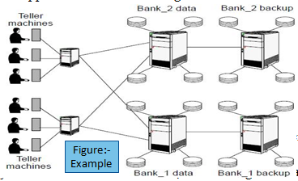
Distributed Operating System
Definition:-
DS can be define as a collection of autonomous computer systems which are capable of communication and cooperation with each other's through high capacity LAN/WAN network.
It can also define a collection of independent computer that appears to its user as a single coherent system.

Slide 52
DOS
Feature:-
In distributed environment all the workstations/systems are geographically separated
Distributed system is a special purpose OS (Advance OS)
Distributed OS is an extension/advancement of Network OS with higher level of communication
DOS is a comparatively more fault tolerance system than NOS
DOS is a loosely coupled system where each computer has its own computational/processing elements/resource (CPU, Memory, etc.)
Transparency is a key design issue of DOS where every details are hidden from user, user can’t get actual status of activity, like replication, Resource, N/W, etc.
Common user cannot predict the execution place (location) on distributed environment
Purpose of DOS:-
How to manage resource effectively
Sharing of information (data)
Transparency[Hide the details]
Replication facility
Large and effective data processing
Applications:-
Telecommunication Networks
Network Applications
Real Time Process Control
Parallel Computation

Slide 53
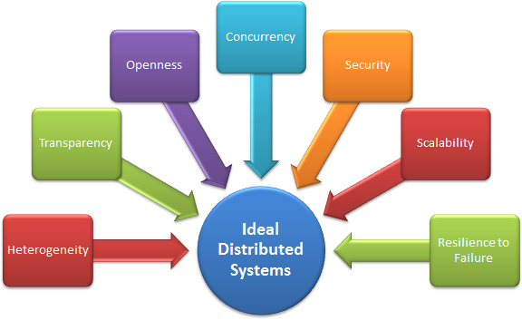
Disadvantages
Advantages:-
Resource sharing
Computational speed up
Reliability
Scalability
Better service to the customers.
Reduction of the load on the host computer.
Disadvantages :-
DOS lacks in common shared memory and clock (global) which leads to many problem like event ordering, synchronization, etc.
Concurrency: How to handle the sharing of resources between clients? Execution of concurrent programs share resources: e.g. web pages, files, etc.
Difficulties of developing distributed software
Networking problems[infrastructure, which have to be dealt with: loss of messages, overloading, ... ]
Security problems: sharing generates the problem of data security.
Expensive
E.g. Mach OS, Chorus OS, etc.

Slide 54
Thank You
We will meet Soon!!!!!!!!!!

Slide 55
Agenda
Real Time Operating System

Slide 56

RTOS
Purpose:-A real-time operating system (RTOS) is an operating system (OS) intended to serve real-time applications that process data as it comes in, typically without buffer delays.
A key characteristic of RTOS (Real Time OS) is the level of its consistency concerning about the amount of time it takes to accept and complete the task.
RTOS always givens O/P in definite time. The time constrains is a main issues in RTOS.
Real time Operating Systems are very fast and quick respondent systems.
These systems are used in an environment where a large number of events
(generally external) must be accepted and processed in a short time.
Real time processing requires quick transaction, RTOS is a one type of multiuser OS.
Job scheduling is the main concern of RTOS, it need to be materialized in proper sequence.
For example, Airplane (Landing, takeoff), lift, radar, airlines reservation system, air traffic control system etc Scientific experiments, medical imaging systems, industrial control systems, weapon systems, robots, air traffic control, Air bags in car
Parameters to be considered
Responsiveness
Available system resources
Open source or professionally licensed
Quality
Safety Certification
Licensing
RTOS Vendor

Slide 57
RTOS
Advantages:
Full utilization of resource Maximum utilization of devices and system.
Task Shifting Time assigned for shifting tasks in these systems are very less.
Focus On Application /Priority Focus on running applications and less importance to applications which are in queue.
Real Time Operating System In Embedded System Since size of programs are small, RTOS can also be embedded systems like in transport and others.
Error Free These types of systems are error free.
Disadvantages:
Limited Tasks Very few task run at the same time and their concentration is very less on few applications to avoid errors.
Costly
Use Heavy System Resources Sometimes the system resources are not so good and they are expensive as well.
Complex Algorithms The algorithms are very complex and difficult for the designer to write on.
Device Driver And Interrupt signals It needs specific device drivers and interrupt signals to response earliest to interrupts.
Job scheduling is difficult

Slide 58
Types of RTOS
1. Hard RTOS
It produces O/P in definite time
If O/P is not produced within the time it leads to huge loss of data
It has less delay than soft RTOS
It needs advance algorithm for job scheduling
Example: Flight controller system
2. Soft RTOS
It is having less time constraints as compared to hard RTOS [occasionally with some acceptably low probability]
If O/P is not produced within the time then loss is considerably less than hard RTOS
It has greater delay than hard RTOS.
Example: Telephone switches

Slide 59
Thank You
We will meet Soon!!!!!!!!!!

